Slide 1


Introduction to Hazardous Space Object Classification
Protecting our planet through detection and classification of Near-Earth Objects using machine learning.

Slide 2
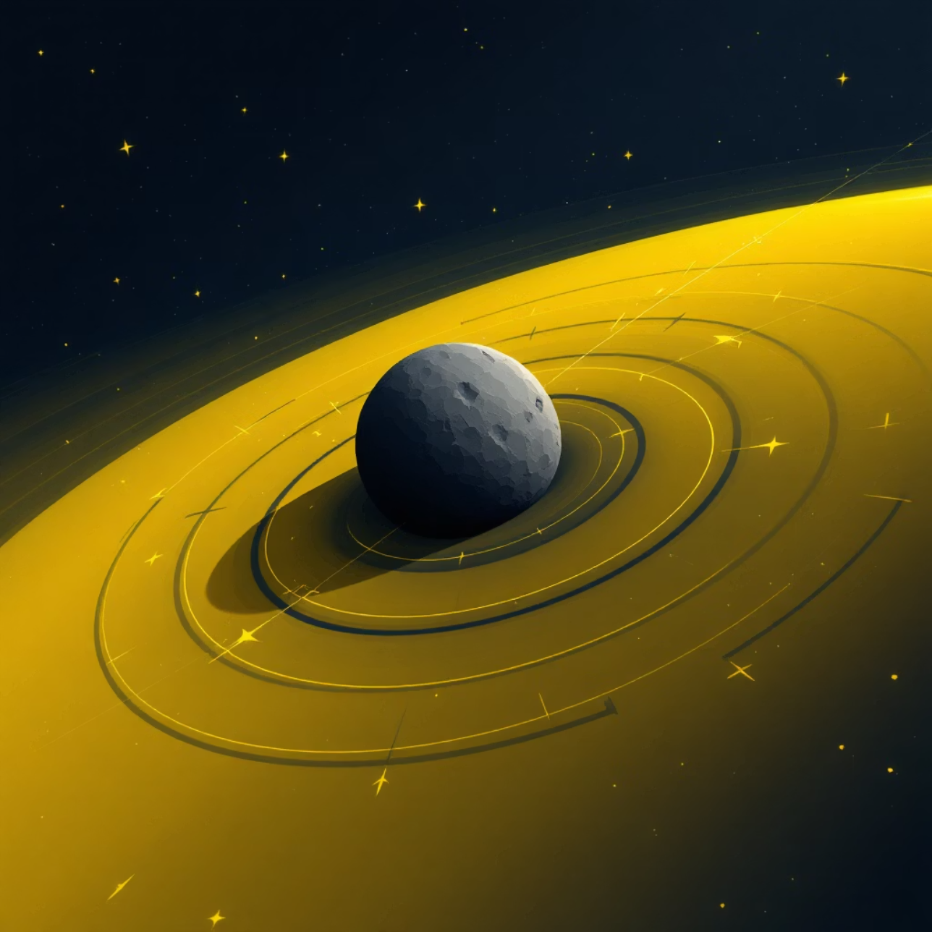

The Problem: Classification of Hazardous and Non-Hazardous Space Objects
Over 20,000 Near-Earth Objects (NEOs) are tracked, with 1,784 classified as potentially hazardous asteroids (PHAs).
What Makes an Object Hazardous?
Greater diameter (larger size)
Higher velocity (faster speed)
Closer proximity to Earth (distance)

Slide 3


Dataset Information
Key Statistics
Data Details
Total Objects: 90,836
Features: id, name, est_diameter_min, est_diameter_max
Columns: 10 features
relative_velocity, miss_distance
Missing Values: None
absolute_magnitude, hazardous
Target Variable: Hazardous (bool)

Slide 4
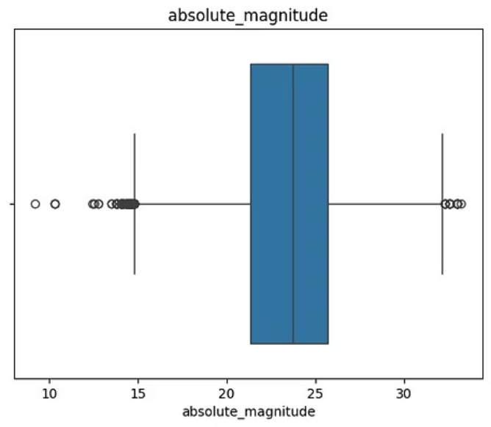
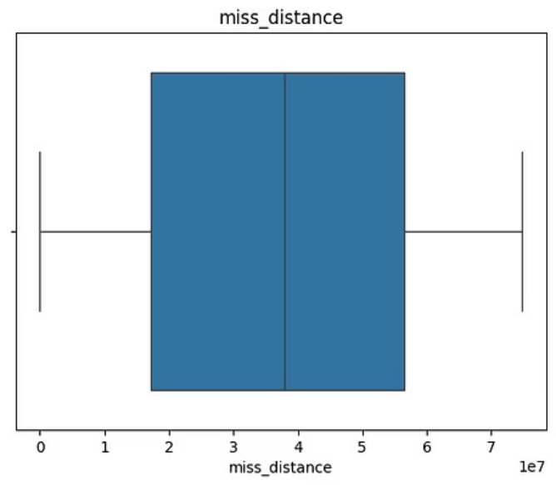
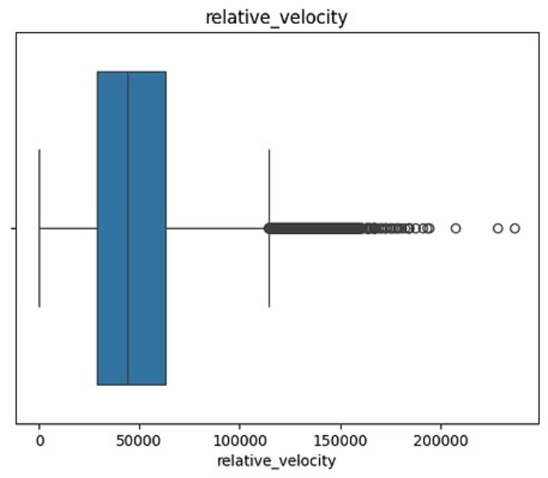
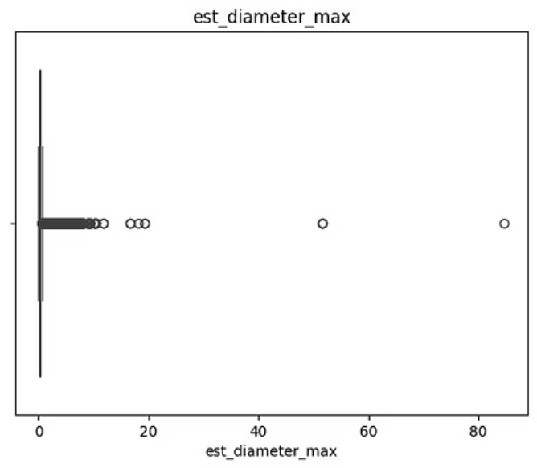

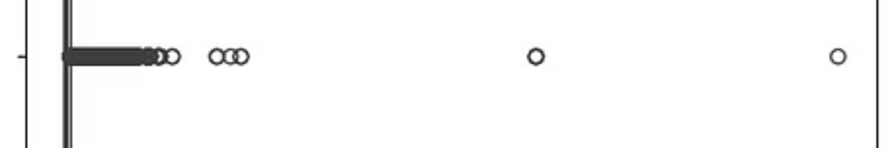


EDA
Outliers Detection
Outliers are extreme values that are differ from rest dataset. It will affect result analysis and model performance.

Slide 5
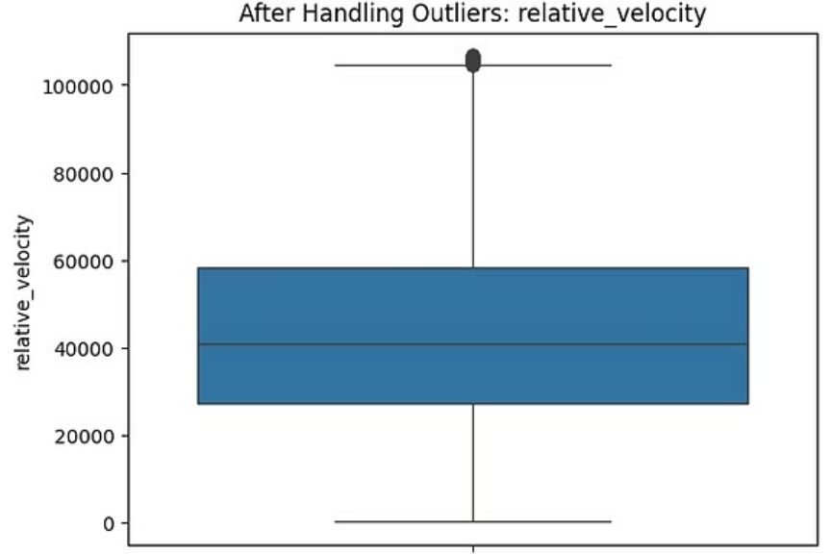
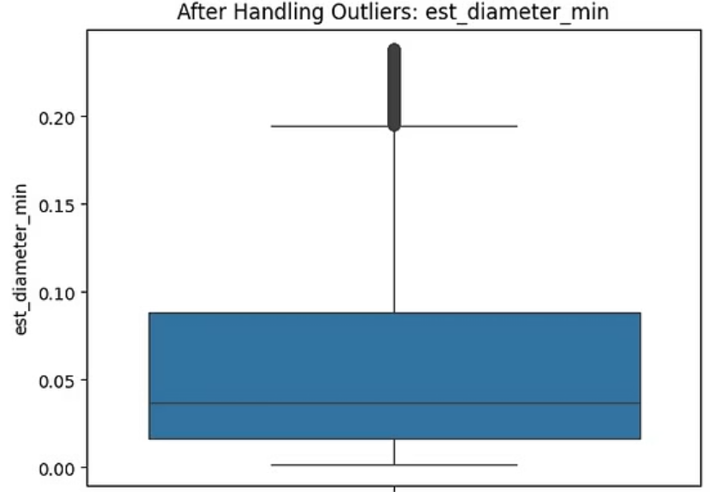
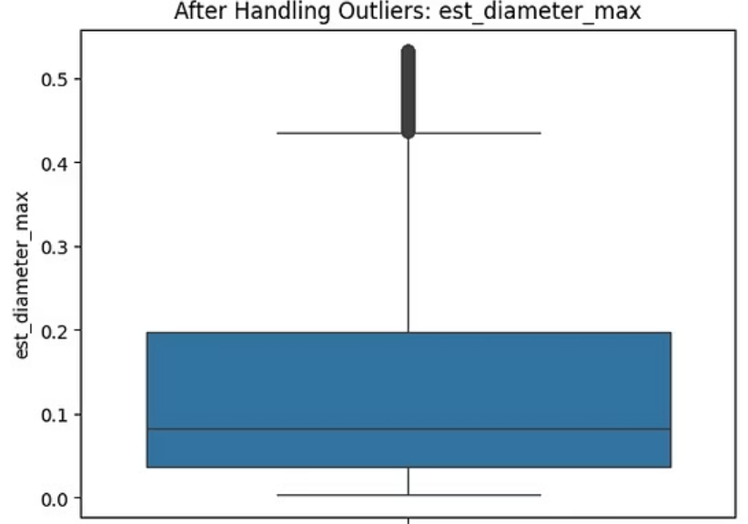
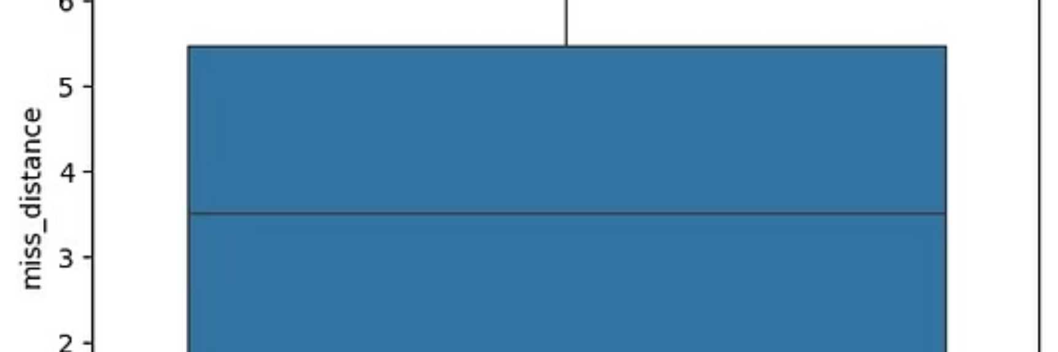
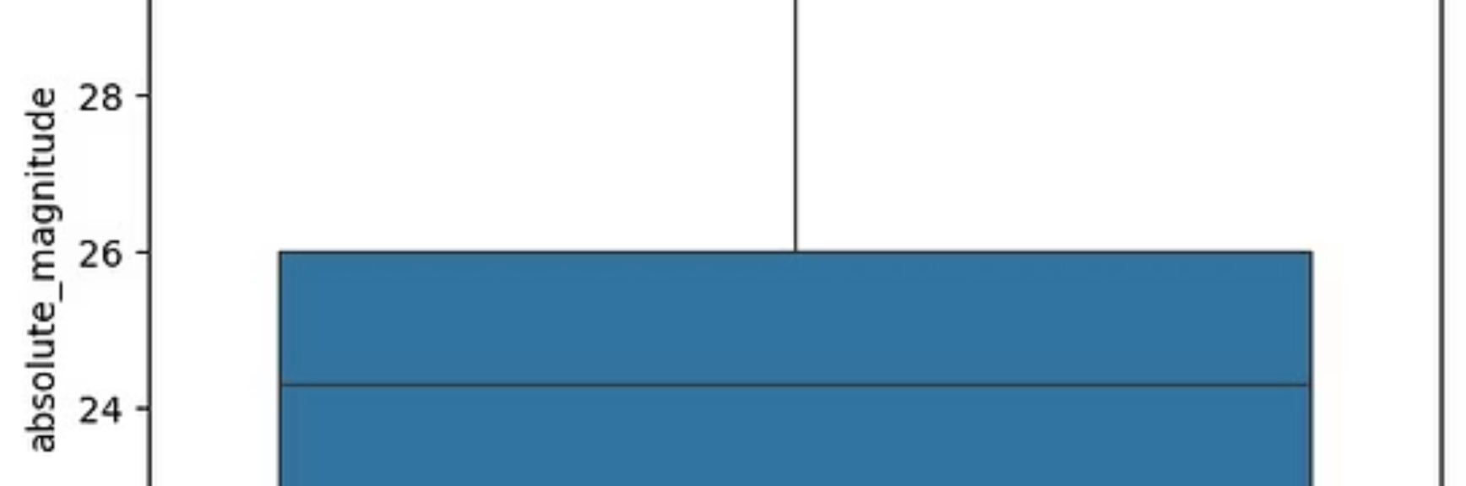


Handling Outliers
01
Outlier Treatment
Remove extreme values using Z-Score for normal data and IQR for skewed data.

Slide 6
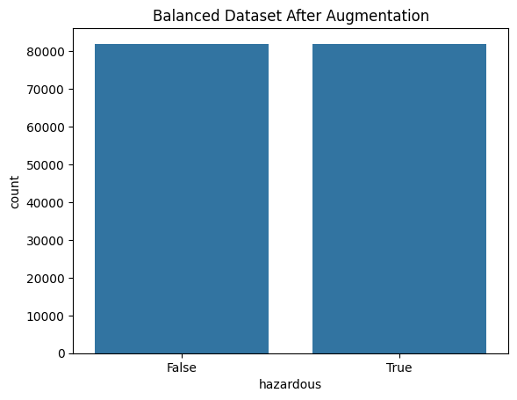



Data balancing
Key Challenge: Class Imbalance
Used technique to balance data: SMOTE oversampling
Before Balancing:
Hazardous: 8,840
Non-hazardous: 81,996
After Balancing:
Hazardous: 81,996
Non-hazardous: 81996

Slide 7







Model 1: Support Vector Machine (SVM)
Approach & Methodology
Performance Metrics
Support Vector Machines create optimal hyperplanes to separate hazardous from non-hazardous objects in high-dimensional feature space.
Kernel: Radial Basis Function (RBF) for non-linear classification
Dataset Split: 80% training, 20% testing with stratification
86%
90%
Overall Accuracy
Model correctly classifies majority of test cases
79%
0%
Precision
Ratio of true positives to all predicted positives
0%
74%
Recall
Successfully identifies hazardous objects
Confusion Matrix Analysis
The confusion matrix reveals strong performance on non-hazardous classification, with some false negatives requiring attention for safety-critical applications.

Slide 8





Model 2: Random Forest
Ensemble Learning Power
Model Performance
Random Forest leverages the wisdom of multiple decision trees, each trained on different subsets of features and data, voting collectively for final classification.
Multiple Decision Trees
95%
Ensemble of 100+ trees reduces overfitting and improves generalisation
Feature Importance
Identifies key orbital parameters like eccentricity and minimum orbit intersection distance
Accuracy
Robust Performance
Improvement over SVM baseline
Handles missing data and maintains accuracy across varied conditions
86%
Precision
Fewer false positives
63%
60%
Recall
Better hazard detection
Confusion Matrix Insights
Random Forest shows balanced performance across both classes, with reduced false negatives compared to SVM—critical for planetary defence applications.

Slide 9


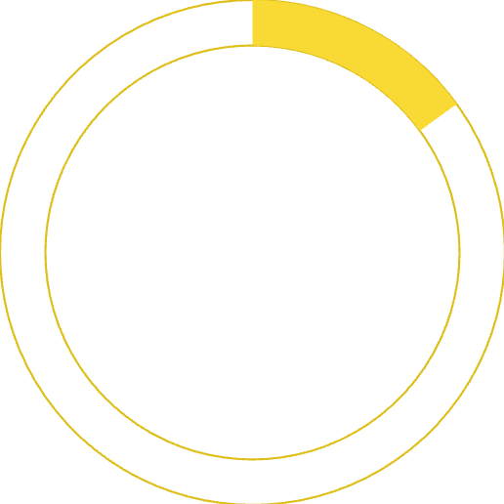


Model 3: XGBoost — The Winner
Why XGBoost Excels
Superior Performance
Gradient Boosting Framework
Sequential learning from previous errors creates powerful predictions
Handles Imbalance
91%
84%
83%
Built-in mechanisms for addressing severely imbalanced datasets
Fast & Scalable
Optimised computation enables rapid training on large astronomical datasets
Accuracy
Precision
Highest overall classification rate
Minimised false alarms
15%
Recall
Best hazard detection capability
XGBoost demonstrates improved F1-score over competing models, validated by recent IEEE 2025 studies on asteroid hazard classification. ROC curves confirm superior discrimination ability across all thresholds.

